Slide 2
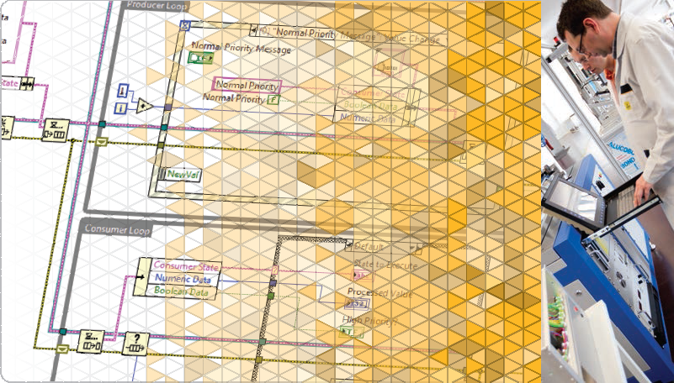
LabVIEW Core 2

Slide 3

Welcome to LabVIEW Core 2
What You Need To Get Started
Complete LearnNI.com Getting Started Modules
Computer running Windows XP or later and LabVIEW 2014

Slide 4

Welcome to LabVIEW Core 2
File Locations
Root Directory
Exercises <or> Solutions
LabVIEW Core 2

Slide 5
Welcome to LabVIEW Core 2
Course Learning Map
Lesson 1
Implementing Design Patterns
Lesson 4
Lesson 2
Using Variables
Communicating Data Between Parallel Loops
Lesson 3
Controlling the User Interface
Lesson 5
Creating and Distributing Applications
Lesson 6
File I/O Techniques
Improving an Existing VI
Lesson 7

Slide 6
Welcome to LabVIEW Core 2
This course prepares you to:
Apply common design patterns that use queues.
Programmatically control user interface objects.
Evaluate file I/O formats and use them in applications.
Modify existing code for improved usability.
Prepare, build, and deploy stand-alone applications.

Slide 7
Lesson 1
Using Variables
Recognize when to use local and global variables and be able to determine the result of block diagrams that use variables.
Variables
Using Variables Appropriately
Race Conditions
Notes:
recognize issues that variables can solve, and be able to create local and
Given a block diagram with local variables, the learner should be able to determine the result. global variables

Slide 8
A. Variables
Identify the differences between local and global variables.

Slide 9

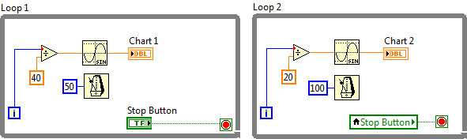
A. Variables
Definition
Variables—Block diagram elements that access or store data from another location.
Notes:
Variables allow you to circumvent normal dataflow by passing data from one place to another without connecting the two places with a wire.
In this course, you learn about and practice with Local variables.
For a brief introduction to Global and Shared Variables, refer to the LabVIEW Core 1 Concepts Manual.
For extended information on Global variables, refer to LabVIEW Help or LabVIEW examples.
You learn about Functional Global variables in LV Core 2.
You learn about Shared variables in courses like LabVIEW Real-Time.

Slide 10
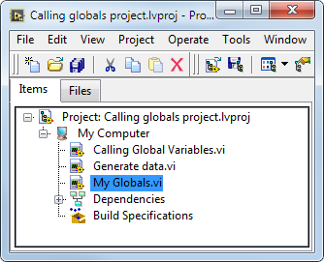
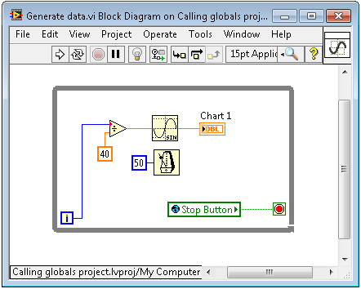
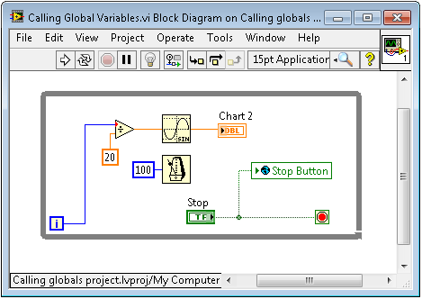
A. Variables
Local versus Global Variables
Notes:
Local—Stores data in front panel controls and indicators.
Global —Stores data in special repositories that can be accessed from multiple VIs.

Slide 11
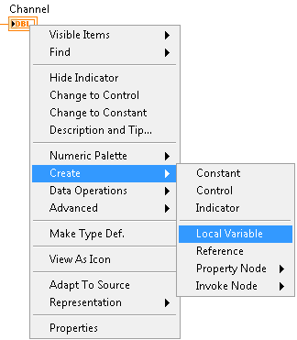
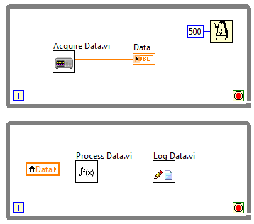
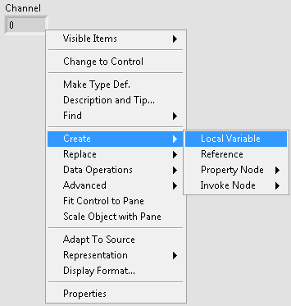
Using Variables

Slide 12
B. Using Variables Appropriately
Recognize issues that variables can solve and drawbacks to using them.

Slide 13
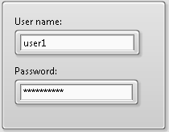
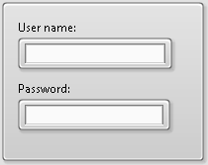
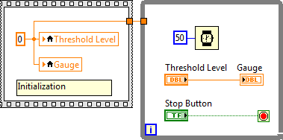
B. Using Variables Appropriately
When to Use Local Variables
Notes:
Writing to controls – for example, to clear a log in screen.
Initializing front panel controls or indicators
Keeping parallel loops parallel.

Slide 14
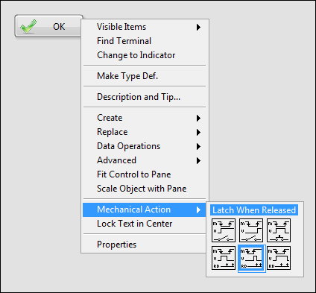

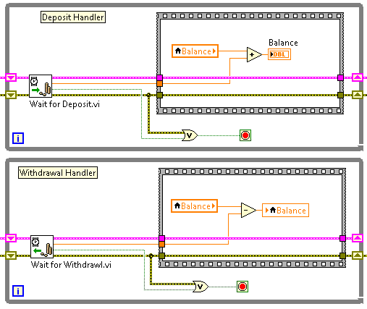
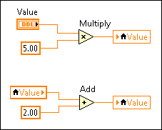
B. Using Variables Appropriately
Drawbacks of Variables
Variable

Slide 15
Exercise 1-1
Weather Station UI VI with Local Variables
Use a local variable to write to and read from a control.

Slide 16
Exercise 1-1
Weather Station UI VI with Local Variables
What functionality does the local variable provide for this application?
Notes:
What functionality does the local variable provide for this application?
If Upper Limit is less than Lower Limit, this VI uses a local variable to change the value of Lower Limit to match the value of Upper Limit.

Slide 17
C. Race Conditions
Identify race conditions and avoid them.

Slide 18
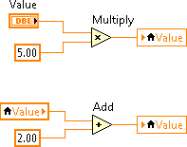
C. Race Conditions
What is a Race Condition?
Race Condition – A situation where the timing of events or the scheduling of tasks may unintentionally affect outputs or values.
Notes:
Race conditions are a common problem for programs that execute multiple tasks in parallel and share data between the tasks.

Slide 19
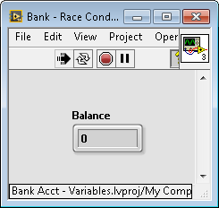
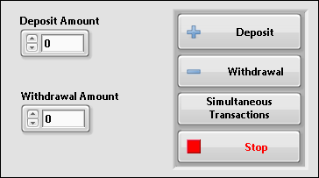
Race Conditions - Bank VI

Slide 20


C. Race Conditions
Avoiding Race Conditions
Variable

Slide 21

Activity 1-1
Lesson Review
Refer to the participant guide to answer questions about what you have learned in this lesson and then discuss the answers as a group.

Slide 22
You should use variables in your VI whenever possible.
True
False
Notes:
Answer is False.

Slide 23
You should use variables in your VI whenever possible.
True
False
You should use variables only when necessary. Use wires to transfer data whenever possible.
Notes:
Answer is False.

Slide 24
When controlling resources, which combination(s) of writers and readers will reduce the risk of race conditions?
One writer, one reader
One writer, multiple readers
Multiple writers, one reader
Multiple writers, multiple readers
Notes:
Answer is a and b.

Slide 25
When controlling resources, which combination(s) of writers and readers will reduce the risk of race conditions?
One writer, one reader
One writer, multiple readers
Multiple writers, one reader
Multiple writers, multiple readers
Notes:
Answer is a and b.

Slide 26
Lesson 2
Communicating Data Between Parallel Loops
Develop code that synchronizes data between parallel loops.
Introduction
Queues
Notifiers
Summary

Slide 27
A. Introduction
Review using local variables to communicate between parallel loops.

Slide 28
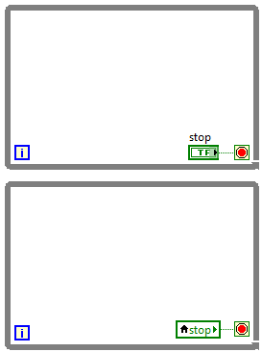
A. Introduction
Communicating Data Between Parallel Loops – Local Variables
Local variables share the latest data between parallel loops.
Loop 1 Code
Loop 2 Code

Slide 29

A. Introduction
If you need to transfer every point of data between parallel loops, should you use a local variable?

Slide 30
B. Queues
Demonstrate how to transfer every point of data between parallel loops using queues.

Slide 31
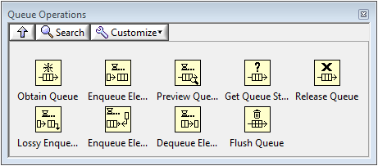
Queues

Slide 32
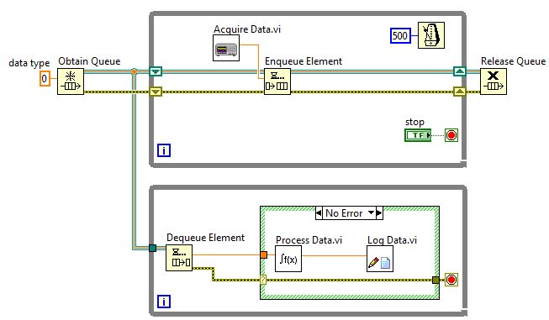
B. Queues
Communicating Data Between Parallel Loops – Queues
Transfer every point of data between parallel loops or VIs

Slide 33
Exercise 2-1
Comparing Queues with Local Variables
Run and examine a producer/consumer design pattern VI that transfers data that a producer loop generates to consumer loops using local variables and queues.

Slide 34
Exercise 2-1
Comparing Queues with Local Variables
What is the data type associated with the queue?
What function returns the current number of elements in the queue?
What is the purpose of the While Loop before the Release Queue?

Slide 35
C. Notifiers
Create code that broadcasts the latest data to waiting parallel loops using notifiers.
Notifiers Operations Palette
Using Notifiers

Slide 36
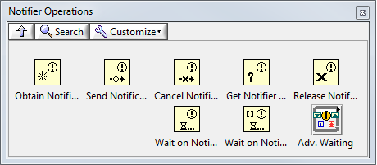
C. Notifiers
What is a Notifier?
Notifier functions—Suspend the execution of a block diagram until it receives data from another section of the block diagram or from another VI running in the same application instance

Slide 37
C. Notifiers
Notifiers vs. Queues
Notifiers do not buffer data, so receiving loops only receive the latest notification
Notifiers can broadcast a notification to multiple loops

Slide 38
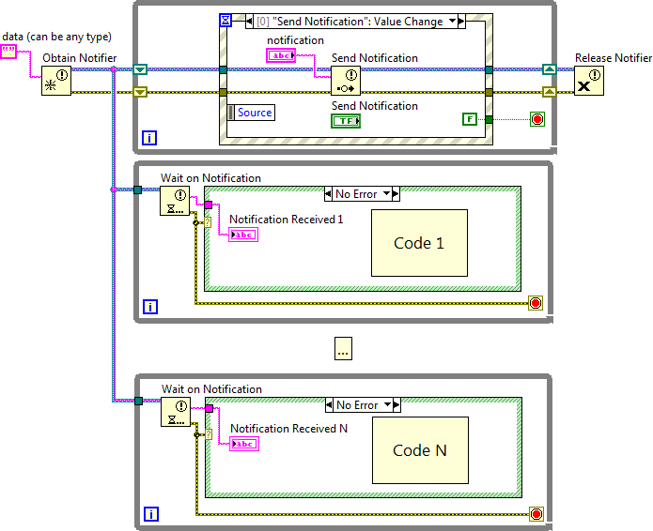
C. Notifiers
Broadcast Data to Parallel Loops

Slide 39
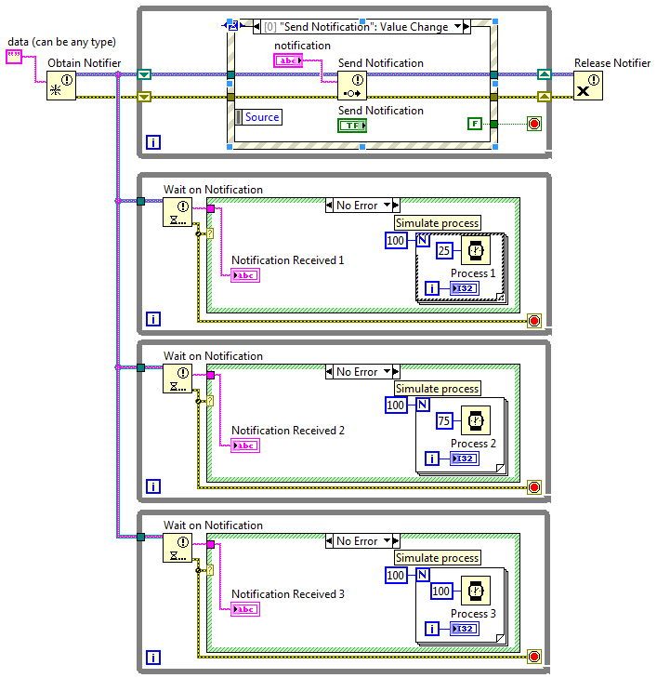
Notifiers
Broadcast the latest data to waiting parallel loops.

Slide 40
D. Summary

Slide 41
D. Summary
Compare Variables, Queues, and Notifiers
 | Suspend execution in reader loop? | Buffers data? | Data can be read by multiple loops? | Use case
Local/global variables |  |  | Yes | Transfer latest data
Queues | Yes | Yes |  | Transfer every point of data
Notifiers | Yes |  | Yes | Transfer latest data to multiple loops that are waiting on a notification

Slide 42
Activity 2-1
Lesson Review
Refer to the participant guide to answer questions about what you have learned in this lesson and then discuss the answers as a group.

Slide 43
Which of the following buffer data?
Queues
Notifiers
Local Variables

Slide 44
Which of the following buffer data?
Queues
Notifiers
Local Variables

Slide 45
Match the following:
Obtain Queue
Get Queue Status
Release Queue
Enqueue Element
a. Destroys the queue reference
b. Assigns the data type of the queue
c. Adds an element to the back of a queue
d. Determines the number of elements currently in the queue

Slide 46
Match the following:
Obtain Queue
Get Queue Status
Release Queue
Enqueue Element
b. Assigns the data type of the queue
d. Determines the number of elements currently in the queue
a. Destroys the queue reference
c. Adds an element to the back of a queue

Slide 47
Which of the following are valid data types for queues and notifiers?
String
Numeric
Enum
Array of Booleans
Cluster of a string and a numeric

Slide 48
Which of the following are valid data types for queues and notifiers?
String
Numeric
Enum
Array of Booleans
Cluster of a string and a numeric
Notes:
The data type of a queue or notifier is set by the data type wired to the element data type input of the Obtain Notifier function or Obtain Queue function. You can wire any data type to these inputs.

Slide 49
Lesson 3
Implementing Design Patterns
Implement common design patterns for single and parallel loop applications.
Why Use Design Patterns?
Simple Design Patterns
Multiple Loop Design Patterns
Functional Global Variable Design Pattern
Error Handlers
Generating Error Codes and Messages
Timing a Design Pattern

Slide 50
A. Why Use Design Patterns?
Describe the benefits of design patterns.

Slide 51
A. Why Use Design Patterns?
Benefits of Design Patterns
Design Patterns—Code implementations and techniques that are solutions to specific problems in software design
Design Patterns:
Evolve through the efforts of multiple developers
Fine-tuned for simplicity, maintainability, and readability

Slide 52
B. Simple Design Patterns
Describe and use simple design patterns.
Simple VI
General VI
State Machine
Event-Based State Machine

Slide 53
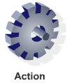
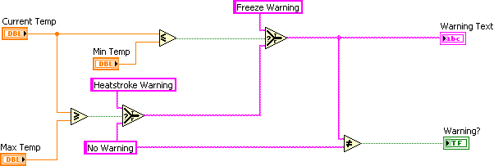
B. Simple Design Patterns
Simple VI Pattern

Slide 54
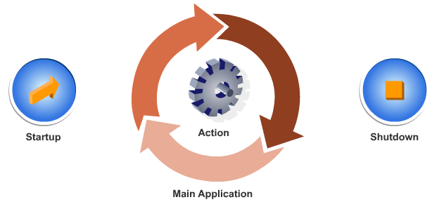
B. Simple Design Patterns
General VI Pattern

Slide 55
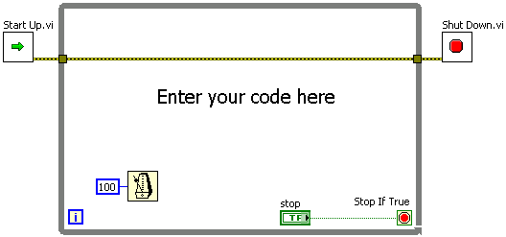
B. Simple Design Patterns
General VI Framework

Slide 56
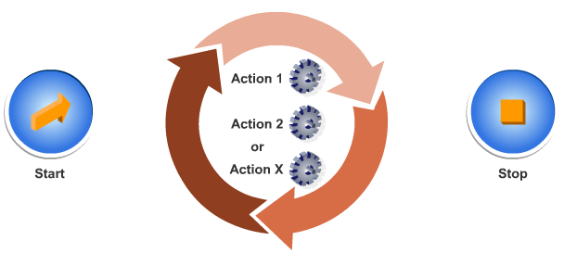
B. Simple Design Patterns
State Machine Pattern

Slide 57
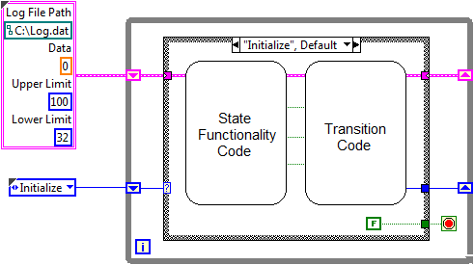
B. Simple Design Patterns
State Machine Framework
Notes:
The decision-making code will contain:
State functionality code (execution), then
A decision on what the next state of execution will be (transition)

Slide 58
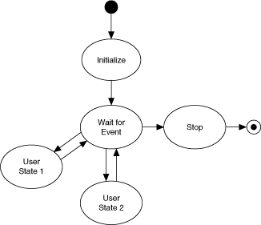
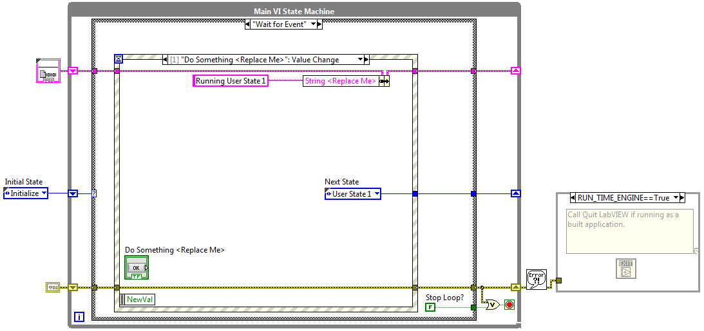
B. Simple Design Patterns
Event-Based State Machine

Slide 59
C. Multiple Loop Design Patterns
Use the producer/consumer (events) design pattern to create multiple loop applications.

Slide 60
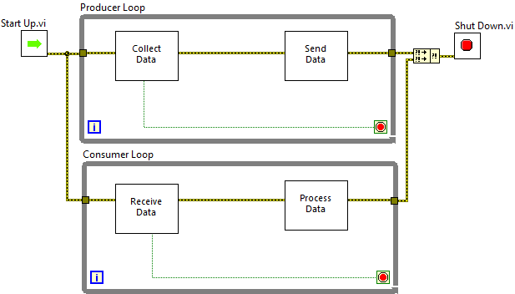
C. Multiple Loop Design Patterns
Producer/Consumer Design Pattern

Slide 61
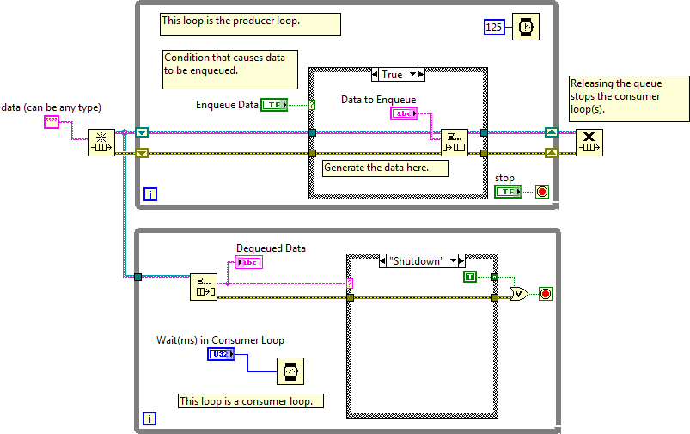
Producer/Consumer (Data) Design Pattern

Slide 62
Exercise 3-1
Group Exercise: Producer/Consumer Design Pattern
Explore the producer/consumer design pattern

Slide 63
Exercise 3-1
Group Exercise: Producer/Consumer Design Pattern
What are the advantages of using a string for the Consumer State value?
What other data type could you use for the Consumer State?

